Slide 1

How to Use this Slide Deck
[Last Updated 08.20.2015]
What’s Included?
Instructional and exercise slides for the LabVIEW Student Ambassadors
End of lesson quiz questions
Exercises that are designated “Homework” exercises
What’s Excluded?
Sections involving hardware

Slide 3
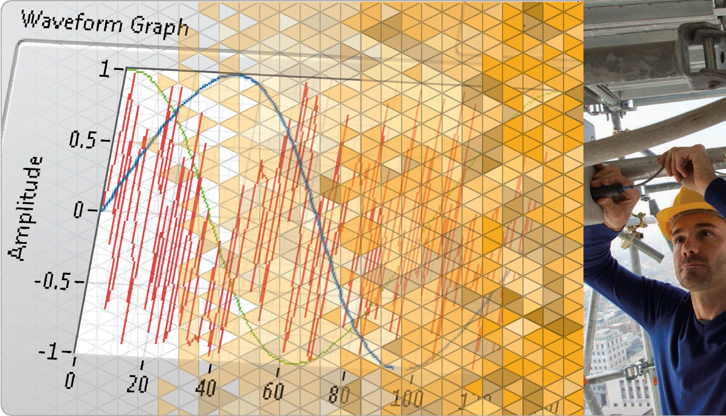
LabVIEW Core 1
Notes:
The slides from here to the first lesson slide are the standard front matter for any course. Any text in red should be replaced with text appropriate to your course.

Slide 4
Welcome to LabVIEW Core 1
Course Learning Map
Lesson 1
Troubleshooting and Debugging VIs
Lesson 4
Lesson 2
Navigating LabVIEW
Creating Your First Application
Lesson 3
Using Loops
Lesson 5
Modularity
Lesson 6
Creating and Leveraging Data Structures
Using Decision-Making Structures
Lesson 7
Lesson 8
Using Sequential and State Machine Programming
Lesson 9
Acquiring Measurements with Hardware
Accessing Files in LabVIEW
Lesson 10
Notes:
<Replace text with your lesson titles. Click each smart art, press the left expand icon, and add or remove Lessons as needed. Resize the smart art to fit the actual number of lessons.>

Slide 5
Lesson 8
Acquiring Measurements from Hardware
Understand how LabVIEW connects to hardware to get real-world measurements.
Measurement Fundamentals with NI DAQ Hardware
Automating Non-NI Instruments

Slide 6
A. Measurement Fundamentals with NI DAQ Hardware
Recognize the components of a DAQ system and practice connecting to hardware.

Slide 7
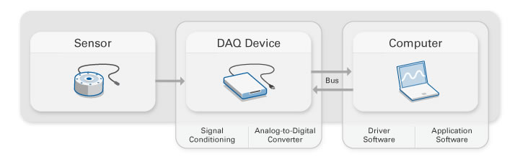
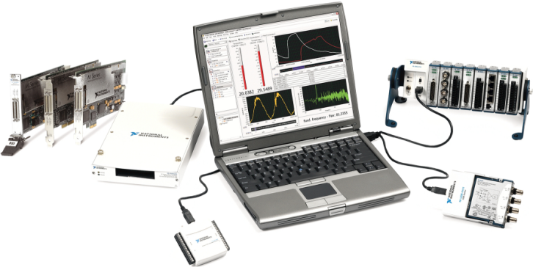
A. Measurement Fundamentals with NI DAQ Hardware
DAQ─Measuring Physical Phenomenon with a Computer

Slide 8
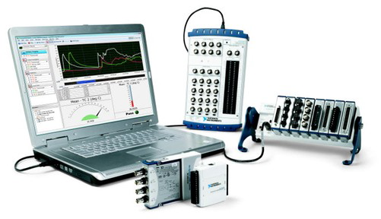
Measurement Fundamentals with NI DAQ
DAQmx
LabVIEW

Slide 9

Exercise 8-1
Using NI MAX to Examine a DAQ Device
Use NI MAX to examine and test a DAQ device.

Slide 10
Exercise 8-1
Using NI MAX to Examine a DAQ Device

Slide 11
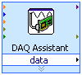
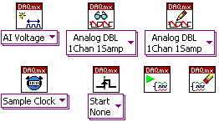
A. Measurement Fundamentals with NI DAQ Hardware
3 Ways to Connect with a DAQ Device
NI MAX
DAQ Assistant
DAQmx API

Slide 12
Exercise 8-2
Programming with the DAQmx API
Explore a DAQmx example program that continuously acquires data and modify it to wait on a digital trigger.

Slide 13
Exercise 8-2
Programming with the DAQmx API
What types of VIs did you use outside of the While Loop?

Slide 14
B. Automating Non-NI Instruments
Recognize the components of an instrument control system and practice connecting to hardware.

Slide 15
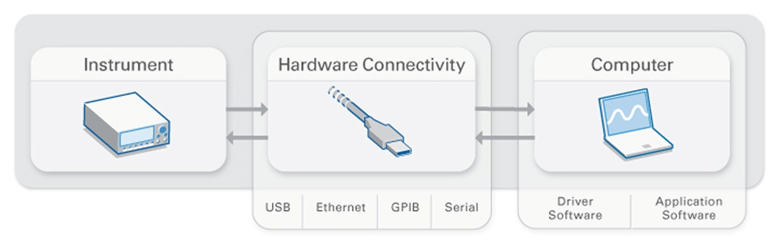
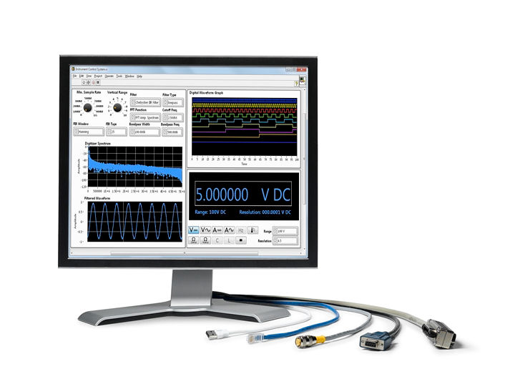
B. Automating Non-NI Instruments
LabVIEW controls instruments through different buses.

Slide 16
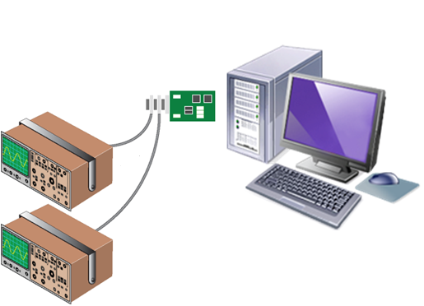
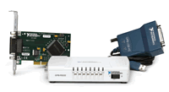
Automating Non-NI Instruments

Slide 17
Exercise 8-3
Instrument Configuration with NI MAX
Use NI MAX to examine and communicate with an instrument using GPIB interface settings.

Slide 18
Exercise 8-3
Instrument Configuration with NI MAX

Slide 19
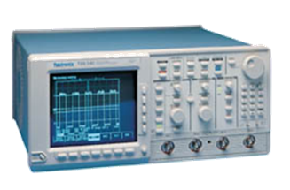
B. Automating Non-NI Instruments
Simplify Instrument Control
LabVIEW
Instrument Driver
Instrument Commands
(*idn?, meas?)
Bus Communication Protocol
(configure, read, write, trigger)

Slide 20
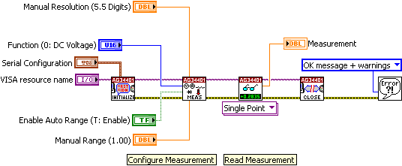
B. Automating Non-NI Instruments
Instrument Driver VIs for an Agilent Digital Multimeter
Notes:
This slide transitions to the next exercise.
The block diagram:
Initializes the Agilent 34401 digital multimeter (DMM)
Uses a configuration VI to choose the resolution and range
Selects the function
Enables or disables auto-range
Uses a data VI to read a single measurement
Closes the instrument
Checks the error status
You can locate most LabVIEW Plug and Play instrument drivers in the Instrument Driver Finder.
Access within LabVIEW by selecting Tools» Instrumentation»Find Instrument Drivers or Help»Find Instrument Drivers.
Use it to connect with ni.com to find instrument drivers.
You can also find instrument drivers at ni.com/idnet
When you install an instrument driver, the installer:
Adds an example program using the driver to the NI Example Finder.
Adds instrument driver VIs to the Instrument I/O»Instrument Drivers palette in the Functions palette.
Extracts instrument driver VIs and supporting files to the <LabVIEW>\instr.lib directory.

Slide 21
Exercise 8-4
Exploring Instrument Drivers
Install an instrument driver and explore the example programs that accompany it.

Slide 22
Exercise 8-4
Exploring Instrument Drivers
How would you modify the example programs if you wanted to continuously acquire data?

Slide 23

Activity 8-1
Lesson Review
Refer to the participant guide to answer questions about what you have learned in this lesson and then discuss the answers as a group.

Slide 24
Lesson Review
What is NI MAX? (multiple answers)
A tool to configure and test DAQ devices
A tool to test instrument communication
A configurable Express VI
A window to view LabVIEW project files
Notes:
Answer is a & b.

Slide 25
Lesson Review
What is NI MAX? (multiple answers)
A tool to configure and test DAQ devices
A tool to test instrument communication
A configurable Express VI
A window to view LabVIEW project files
Notes:
Answer is a & b.

Slide 26
Lesson Review
Which of the following are benefits of instrument control? (multiple answers)
Automate processes
Improve productivity and repeatability
One platform for multiple tasks
Limited to only one type of instrument
Notes:
Answer is a, b, and c.

Slide 27
Lesson Review
Which of the following are benefits of instrument control? (multiple answers)
Automate processes
Improve productivity and repeatability
One platform for multiple tasks
Limited to only one type of instrument
Notes:
Answer is a, b, and c.

Slide 28
Lesson Review
VISA is a high-level API that calls low-level drivers.
True
False
Notes:
Answer is a.

Slide 29
Lesson Review
VISA is a high-level API that calls low-level drivers.
True
False
Notes:
Answer is a.

Slide 30
Lesson 9 Accessing Files in LabVIEW
Describe the basic concept of file I/O and apply the appropriate File I/O functions to a given scenario.
Accessing Files from LabVIEW
High-Level and Low-Level File I/O Functions
Comparing File Formats

Slide 31
A. Accessing Files from LabVIEW
Identify the steps for writing and reading files from a LabVIEW application.

Slide 32
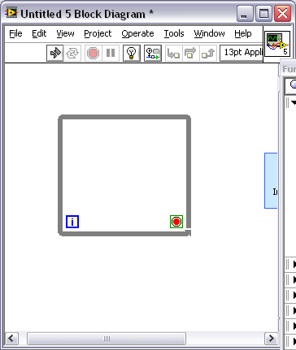
A. Accessing Files from LabVIEW
Typical File I/O Operations
Open/ Create/ Replace File
Read
and/or Write to File
Close
File
Check for
Errors
Notes:
File I/O operations pass data to and from files. Use the File I/O VIs and functions to handle all aspects of file I/O.
A typical file operation involves the following process: Open/Initialize/Create -> Read/Write -> Close the reference -> Check for errors

Slide 33
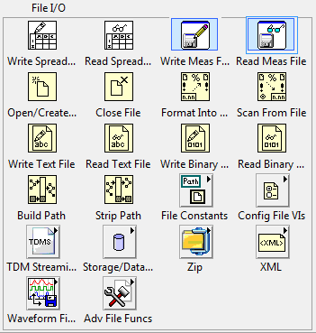
A. Accessing Files from LabVIEW
File I/O Palette for File Operation Functions

Slide 34
B. High-Level and Low-Level File I/O Functions
Identify when to use high-level and low-level File I/O functions.

Slide 35
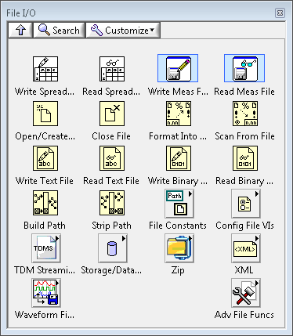
B. High-Level and Low-Level File I/O Functions
High-Level File I/O
Open/ Create/ Replace File
Read
and/or Write to File
Close
File
Check for
Errors
Notes:
High-level File I/O functions:
Perform all three steps (open, read/write, close) for common file I/O operations.
Might not be as efficient as the functions configured or designed for individual operations.
Write to Spreadsheet File
Converts an array of double-precision numbers to a text string and writes the string to an ASCII file.
Read From Spreadsheet File
Reads a specified number of lines or rows from a numeric text file and outputs a 2D array of double-precision numbers.
Write To/Read From Measurement File
Express VIs that write data to or read data from an LVM or TDMS file format.

Slide 36
Exercise 9-1
Exploring High-Level File I/O
Observe how a high-level file I/O VI writes to a spreadsheet-readable file.

Slide 37
Exercise 9-1
Exploring High-Level File I/O
How would you include more columns of data in the log file?

Slide 38
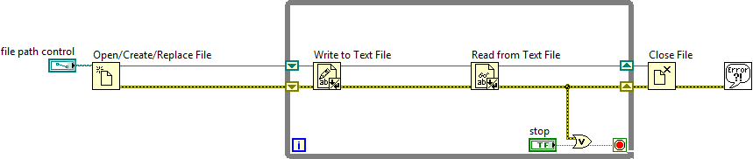
B. High-Level and Low-Level File I/O Functions
Low-Level File I/O
Open/ Create/ Replace File
Read
and/or Write to File
Close
File
Check for
Errors
Notes:
A refnum is a temporary pointer to the resource

Slide 39
B. High-Level and Low-Level File I/O Functions
File Refnums
Identify unique file I/O sessions.
refnum

Slide 40
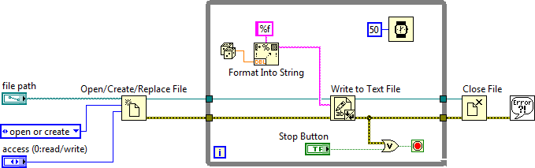
B. High-Level and Low-Level File I/O Functions
Streaming Data to Disk
Notes:
Explain the concept of disk streaming here. Emphasize opening and closing the file outside of the loop.
Low-level File I/O functions:
Provide individual functions for each step.
Are efficient for writing to a file in a loop.

Slide 41
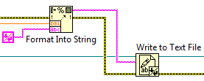
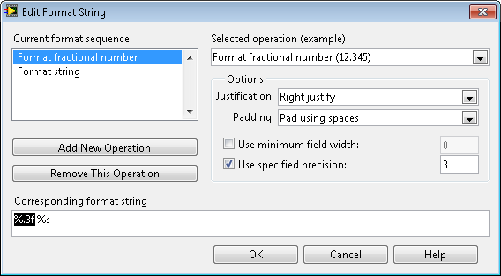
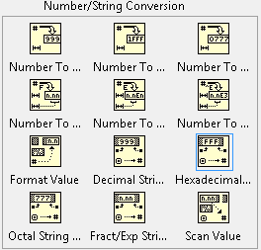
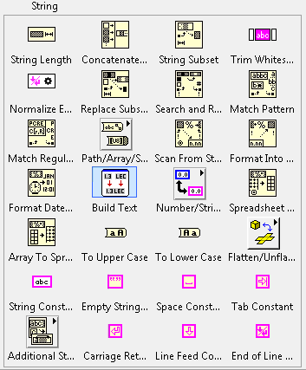
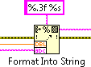
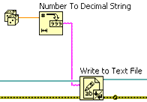
B. High-Level and Low-Level File I/O Functions
String Functions
Convert data types to text
Notes:
To write data to a text file, you must convert your data to a string. To write data to a spreadsheet file, you must format the string as a spreadsheet string, which is a string that includes delimiters, such as tabs.
Converting numeric and Boolean data types to strings and string operations basics

Slide 42
Exercise 9-2
Temperature Monitor VI—Logging Data
Modify a VI to create an ASCII file using disk streaming.

Slide 43
Exercise 9-2
Temperature Monitor VI—Logging Data
What would happen if you used the Open/Create/Replace File and Close File functions inside the While Loop?

Slide 44
C. Comparing File Formats
Recognize different options for logging data to disk.

Slide 45
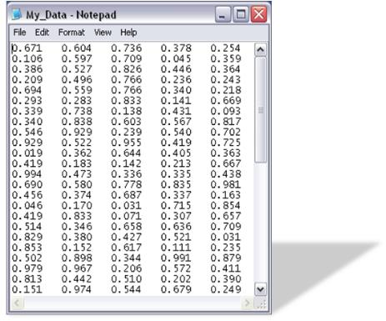
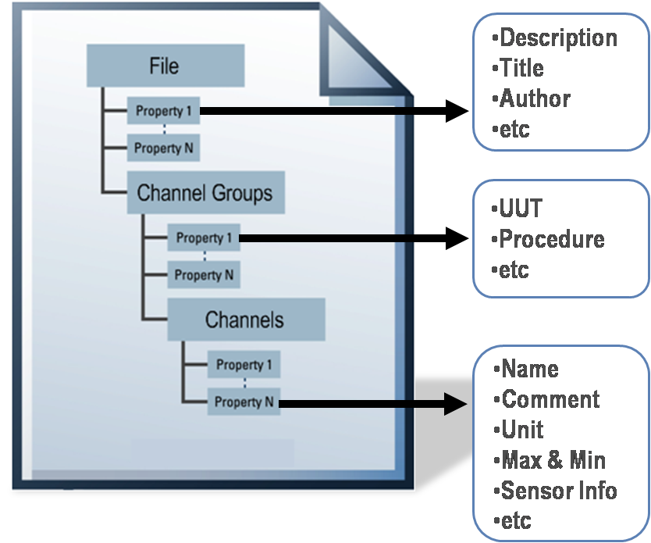
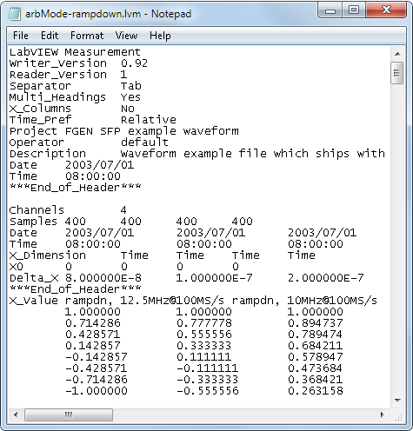
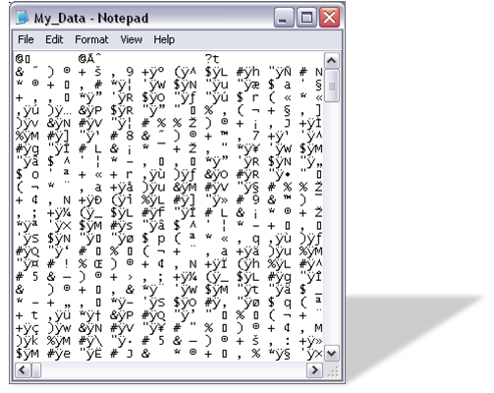
C. Comparing File Formats
Common Log File Formats
TDMS
ASCII/ LVM
Binary
Notes:
LabVIEW can use or create the following file formats:
Binary—Efficient, compact, and allows random access reading but not a human-readable file. Commonly used for high-speed and multi-channel DAQ.
ASCII—Human-readable text file where data is represented as strings. Commonly used for low-speed DAQ.
LVM—Format built on ASCII, the LabVIEW measurement data file (.lvm) is a tab-delimited text file you can open with a spreadsheet application or a text-editing application.
TDMS—An NI-specific binary file format that contains data and stores properties about the data.
ASCII files are also called text files.
Students will learn more about TDMS files in LabVIEW Core 2.

Slide 46

C. Comparing File Formats
Comparing File Formats
 | ASCII | Binary | TDMS | LVM
Easily Exchangeable
Small disk footprint
Random read/write access
Inherent attributes
High-speed streaming
Notes:
In this course, you learn about creating text (ASCII) files.
Use ASCII files in the following situations:
You want to access the file from another application.
Disk space and file I/O speed are not crucial.
You do not need to perform random access reads or writes.
Numeric precision is not important.

Slide 47
Activity 9-1
Lesson Review
Refer to the participant guide to answer questions about what you have learned in this lesson and then discuss the answers as a group.

Slide 48
Lesson Review
After opening a file, which output does the Open/Create/Replace File I/O function return?
File path
File name
Refnum out
Task out
Notes:
Answer is c.

Slide 49
Lesson Review
After opening a file, which output does the Open/Create/Replace File I/O function return?
File path
File name
Refnum out
Task out
Notes:
Answer is c.

Slide 50
Lesson Review
Which file format is best in an application that requires high-speed streaming?
ASCII
Binary
TDMS
LVM
Notes:
Answer is c.

Slide 51
Lesson Review
Which file format is best in an application that requires high-speed streaming?
ASCII
Binary
TDMS
LVM
Notes:
Answer is c.

Slide 52
Lesson 10
Using Sequential and State Machine Programming
Recognize the benefits of sequential and state-based algorithms and apply techniques in LabVIEW to enforce sequential or state execution.
Using Sequential Programming
Using State Programming
State Machines

Slide 53
A. Using Sequential Programming
Use dataflow to ensure sequential execution of nodes.
Why Use Sequential Programming?
Flow-Through Parameters
Sequence Structures
Error Case Structures

Slide 54
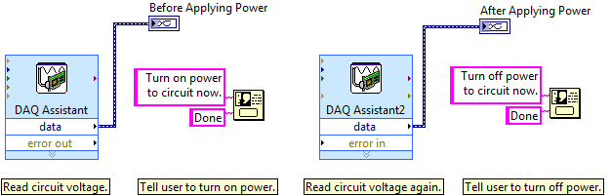
A. Using Sequential Programming
Why Use Sequential Programming?

Slide 55
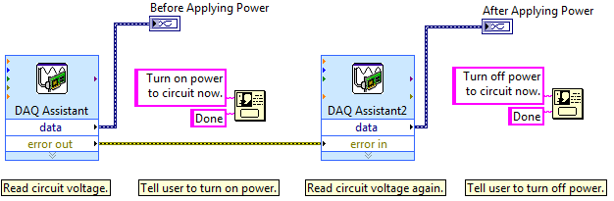
A. Using Sequential Programming
Flow-Through Parameters

Slide 56
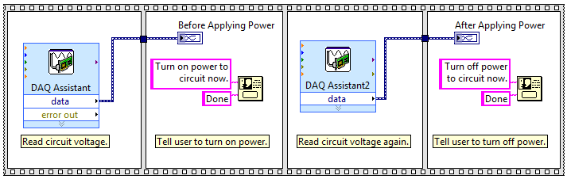
A. Using Sequential Programming
Sequence Structures
Sequence structures are a structure with frames, where each frame executes in order.

Slide 57
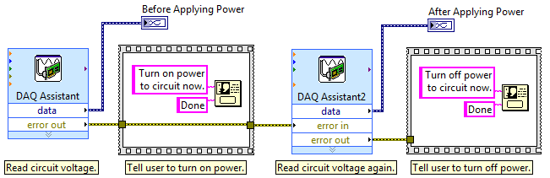
A. Using Sequential Programming
Avoid Overuse of Sequence Structures
Cannot stop the execution in the middle of a sequence.

Slide 58
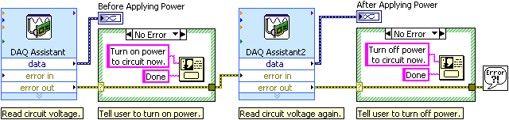
A. Using Sequential Programming
Error Case Structures

Slide 59
B. Using State Programming
Describe the functionality represented by a state transition diagram.
Why Use State Programming?
State Transition Diagrams

Slide 60
B. Using State Programming
Why Use State Programming?
Change the order of a sequence
Repeat an item in sequence more often than others
Execute only if certain conditions are met
Stop the program immediately

Slide 61

B. Using State Programming
State Transition Diagram
State—Part of a program that satisfies a condition, performs an action, or waits for an event
Transition—Condition, action, or event that causes the program to move to the next state

Slide 62
B. Using State Programming
State Transition Diagram

Slide 63
C. State Machines
Determine when to use a state machine.
What is a State Machine?
When to Use a State Machine?
Building a State Machine
Event-Based State Machine
Simple State Machine Project Template

Slide 64
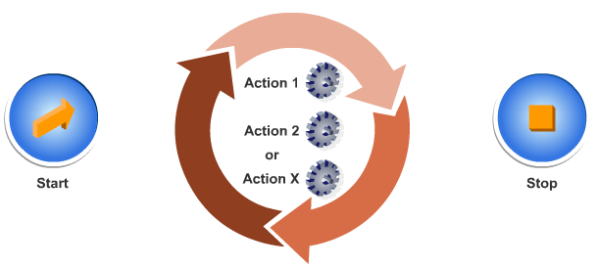
C. State Machines
What is a State Machine?

Slide 65
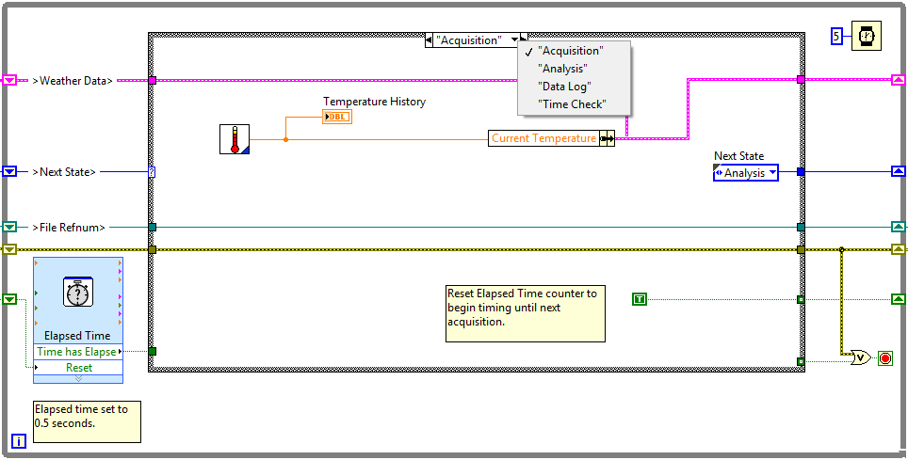
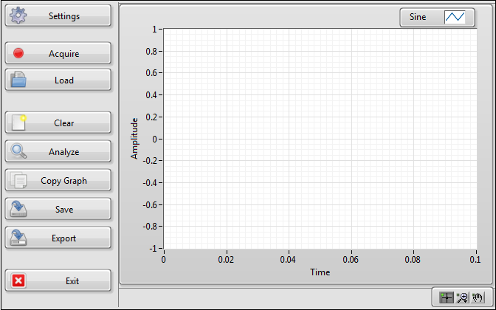
C. State Machines
When to Use a State Machine
Sequential Process
UI-Driven Process

Slide 66
Building State Machines
State Machine Infrastructure
State Machine Transitions
Building State Machines

Slide 67
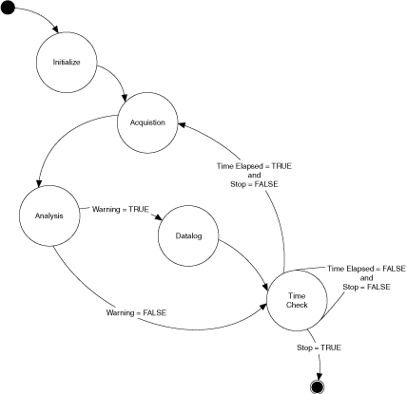
C. State Machines
Course Project Transition Diagram

Slide 68
Exercise 10-1
Weather Station Project
Create a Weather Station application using a state machine design pattern. Practice skills learned throughout this course.

Slide 69
Exercise 10-1
Weather Station Project
How would you change the diagram to add an Initialize and Shutdown state?

Slide 70
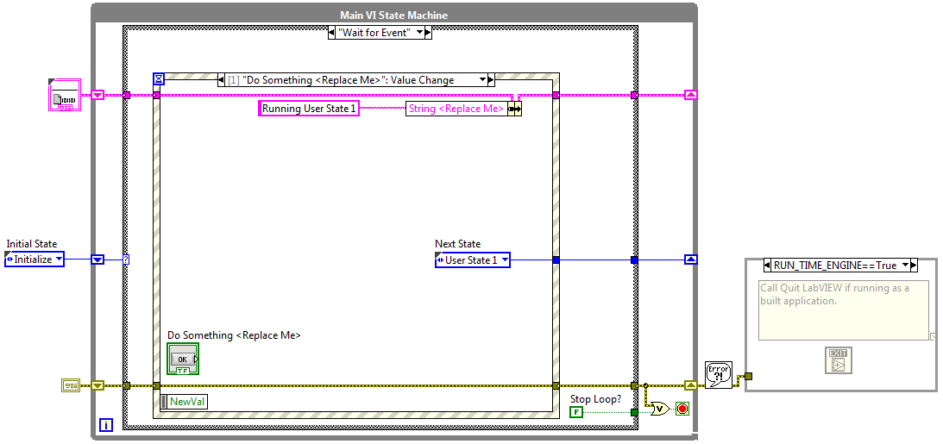
C. State Machines
Event-Based State Machine

Slide 71
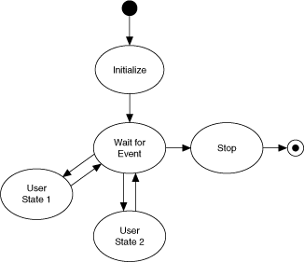
Simple State Machine Project Template
Use the Create Project dialog box to expedite implementing an event-based state machine application.

Slide 72
Activity 10-1
Lesson Review
Refer to the participant guide to answer questions about what you have learned in this lesson and then discuss the answers as a group.

Slide 73
Lesson Review
When using a Sequence structure, you can stop the execution in the middle of a sequence.
True
False
Notes:
Answer is False.

Slide 74
Lesson Review
When using a Sequence structure, you can stop the execution in the middle of a sequence.
True
False You cannot stop the execution in the middle of a sequence.

Slide 75
Lesson Review
Which of the following are benefits of using a state machine instead of a sequential structure?
You can change the order of the sequence.
You can repeat individual items in the sequence.
You can set conditions to determine when an item in the sequence should execute.
You can stop the program at any point in the sequence.
Notes:
Answer is a, b, c, and d.

Slide 76
Lesson Review
Which of the following are benefits of using a state machine instead of a sequential structure?
You can change the order of the sequence.
You can repeat individual items in the sequence.
You can set conditions to determine when an item in the sequence should execute.
You can stop the program at any point in the sequence.

